Slide 1
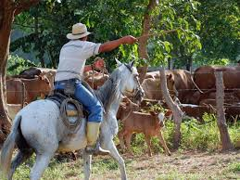

MY FAVORITE ANIMAL
MY FAVORITE ANIMAL IS THE HORSE, SINCE IT HAS SERVED MAN SINCE THE BEGINNING OF CIVILIZATION, IT HAS CONTRIBUTED TO DEVELOPMENT AND TRADE AMONG PEOPLES. NOWADAYS, IT IS A FUNDAMENTAL TOOL IN THE WORK OF THE COLOMBIAN COUNTRYSIDE, IN THE SAME WAY IT IS USED FOR SPORTS, TOURISM AND FUN ACTIVITIES IN ECOLOGICAL WALKS.

